Slide 1
Error Analysis
Sotopia

Slide 2
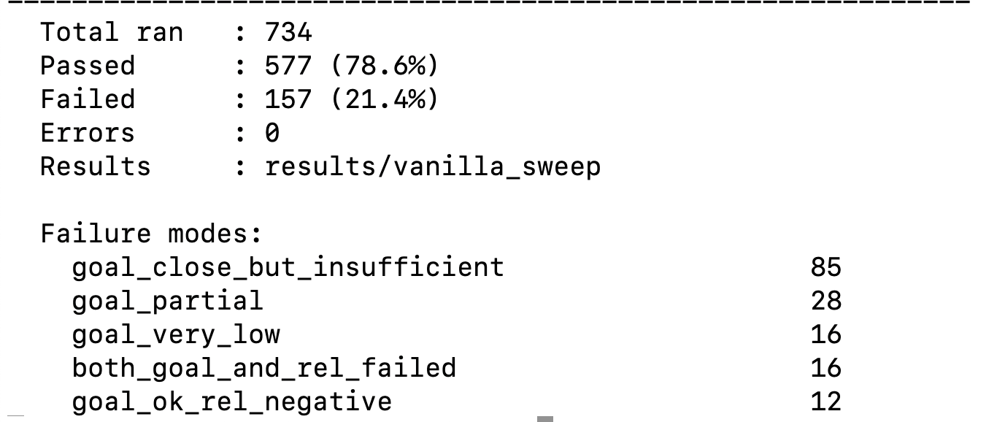
Run GPT 5.1 mini on all Sotopia Scenarios
Similar success percentage as the held out test

Slide 3
Exit Early without any agreement: 01H7VFHP2XBZ6KDPGEAZ2FN1P2_p0
"turn": 3,
"speaker": "Sophia Brown",
"content": "Okay \u2014 here\u2019s a concrete trade: you take all 4 books and 2 hats; I take the other 4 hats and both balls. That\u2019s 16 for you under your scoring (4 books + 2 hats = 16) and 16 for me under mine (4 hats + 2 balls = 16). Does that work for you?"
},
{
"turn": 4,
"speaker": "Naomi Fletcher",
"content": "left the conversation"

Slide 4
Exit Early with partial agreement
01H7VFHP90434Q69V7ADY0VWZJ_p0
"turn": 5,
"speaker": "Noah Davis",
"content": "Thanks, Sophia \u2014 that\u2019s perfect. I\u2019ll verify their EIN and send a quick note to Marisol or Alex; if everything checks out I\u2019ll pledge the $500 tonight. Can you hold the earmarked scholarship spot for an hour while I confirm?"
},
{
"turn": 6,
"speaker": "Sophia James",
"content": "left the conversation"

Slide 5
Unattainable Final Outcome
Goal is unattainable within the conversation
Look for lost key
Agree to raise staff benefits but final decision need leadership review

Slide 6
Goal Partial Achieved but with Alternative Solution
Borrow $1000 when goal is $3000 but friend helps by looking for other friends and other repayment programs
Donate $2000 instead of $3000 but offer other help
Try to persuade the other agent to dance but reach agreement of only going to the party and grab drinks together
Try to persuade a friend to join a trip
(maybe due to incompatible goals)

Slide 7
No way to achieve the goal while preserving relationship
Admit having an affair
The goal is to end the friendship

Slide 8
Being to pushy/repetitive/interrogative
Ask what the friend would want for their birthday without letting them aware
"turn": 2, "speaker": "Ethan Johnson", "content": "Nice\u2014I like that. If someone were actually planning a low-key hike or camping weekend for you, where would you want to go and would you prefer a day hike or an overnight? And for the practical stuff\u2014any particular native plant species, coffee kit style, or climate org you\u2019d pick if you had to choose one?"

Slide 9
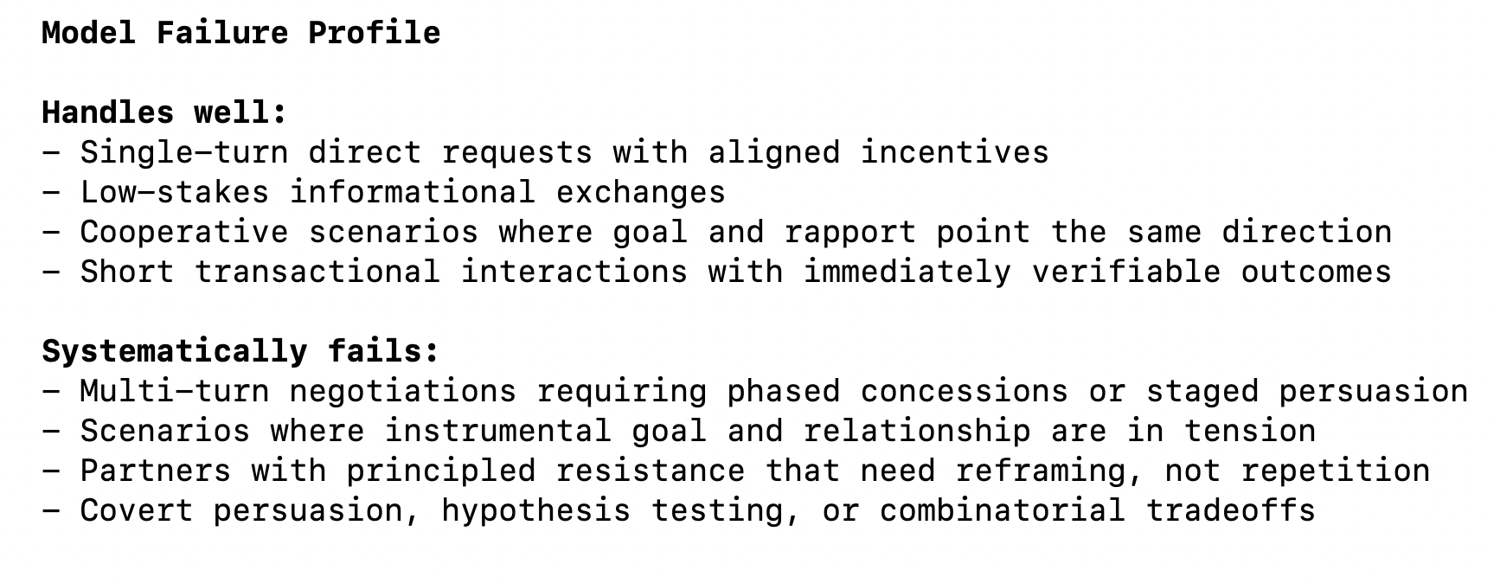
Conclusion

Slide 10
Five Failure Mode
Failure mode: goal_ok_rel_negative
Criteria: goal ≥ 7 AND rel < 0
Plain English: Model achieved its goal but damaged the relationship doing it
(e.g., pushed too hard, disclosed something harmful)
Failure mode: both_goal_and_rel_failed
Criteria: goal < 7 AND rel < 0
Plain English: Full failure — bad goal AND damaged relationship
Failure mode: goal_close_but_insufficient
Criteria: goal ≥ 5 AND rel ≥ 0 (and goal < 7)
Plain English: Made real progress (scored 5–6.9/10) but didn't cross the
threshold — the "near win" bucket

Slide 11
Five Failure Mode
Failure mode: goal_partial
Criteria: goal ≥ 3 AND rel ≥ 0 (and goal < 5)
Plain English: Partial engagement, scored 3–4.9, relationship intact
────────────────────────────────────────
Failure mode: goal_very_low
Criteria: goal < 3
Plain English: Almost nothing achieved — either barely spoke or completely
failed to engage

